Slide 1

Unit-01 Introduction to Python
Python for Data Science (2305CS303)
Prof. Shruti Maniar
Computer Engineering Department
shruti.maniar@darshan.ac.in
(O) 9727747317

Slide 2

Outline
Introduction to python
Advantages of python
Installing python
Program Structures
User interface and IDE
Indentation
Reading input
Print output
Looping

Slide 3
Syllabus
Reference Book:
Programming in Python 3 : A Complete Introduction to the Python Language
Introduction to Computation and Programming using Python
Core Python Programming
Python for Data Science for Dummies
Python for Data Analysis
Introduction to Machine Learning with Python
Sr. No. | Unit
1 | Introduction to Python, Object and Data Structure, Python Operators
2 | Conditional and Looping Statements, Functions in Python
3 | Numpy and Beautiful Soup
4 | Pandas
5 | Matplotlib

Slide 4

Introduction to Python
Python is a programming language developed by Guido van Rossum of Netherlands in 1991.
Python is an open source, interpreted, high-level and general-purpose programming language.
Python's design philosophy emphasizes code readability with its notable use of significant whitespace.
Python is dynamically typed and garbage-collected language.
Python was inspired by the ABC language that was developed in 1980s.
Python version gets updated time to time.
The latest version is Python 3.13

Slide 5
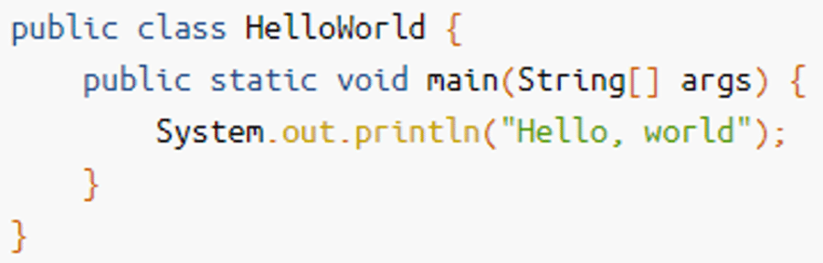
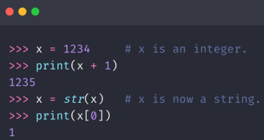
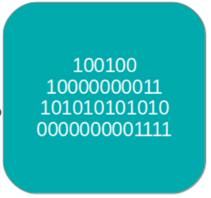
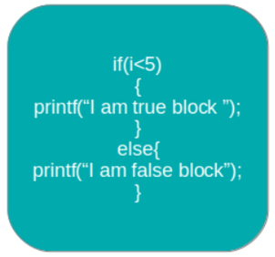
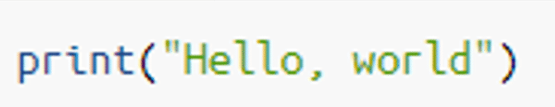
Advantages of Python
Easy to Read, Learn and Understand
Codes written in Python is simple and readable.
Uses more English keywords.
It has fewer syntax constructions than other languages.
High-Level Language
Python is closer to human language than machine code (low-level language).
We do not need to manually allocate/deallocate memory, as garbage collector takes care of unused memory automatically.
This gives you the ability to program at a faster rate.
Dynamically Typed
Python automatically assigns the data type during execution.
The programmer doesn’t need to worry about declaring variables and their data types.
Java
Low-Level Language
Python
High-Level Language
Automatic Data type Assignment

Slide 6
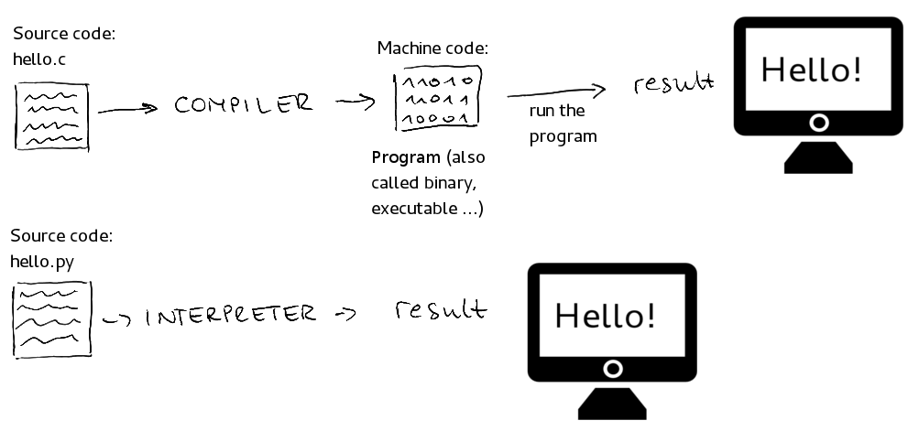
Advantages of Python (cont.)
Interpreted Language
A program written in high-level language has to be either compiled or interpreted.
Python is an interpreted language which means that Python directly executes the code line by line.
In case of any error, it stops further execution and reports back the error which has occurred.
C : compiled language
Python : interpreted language

Slide 7


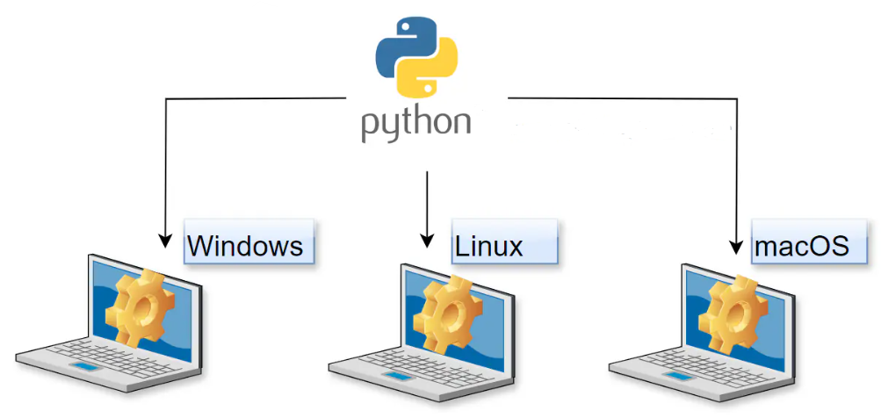
Advantages of Python (cont.)
Free and Open-Source
Python comes under the OSI approved open-source license. This makes it free to use and distribute.
The Python Software Foundation distributes pre-made binaries that are freely available for use on all major operating systems called CPython.
You can get CPython’s source-code, too.
Also you can modify the source code and distribute it, as allowed by CPython’s license.
Platform Independent and Portable
In many languages like C/C++, you need to change your code to run the program on different platforms. That is not the same with Python. You only write once and run it anywhere.
Python runs on all major operating systems like Microsoft Windows, Linux, and Mac OS X.

Slide 8
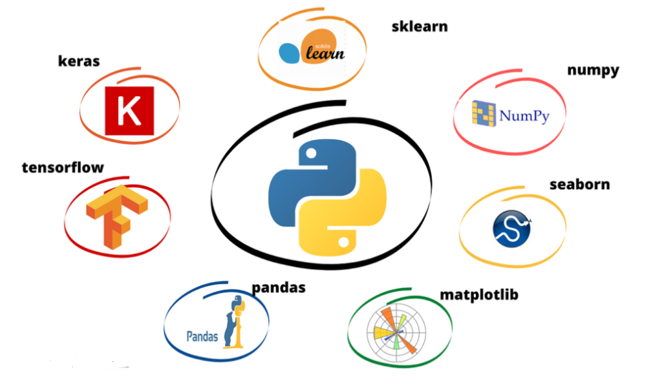
Advantages of Python(cont.)
Vast Libraries Support
Python has huge libraries available.
The standard library of Python is huge, you can find almost all the functions needed for your task. So, you don’t have to depend on external libraries.
Improved Productivity
Python is a very productive language.
Due to the simplicity of Python, developers can focus on solving the problem.
It’s Safe
Python doesn’t have pointers like other C-based languages, making it much more reliable.
Along with that, errors never pass silently unless they’re explicitly silenced.
This allows you to see and read why the program crashed and where to correct your error.

Slide 9
Installing Python
Installation for Windows & Mac
To install python in windows you need to download installable file from https://www.python.org/downloads/
After downloading the installable file you need to execute the file.
Installation for Linux
For ubuntu 16.10 or newer
sudo apt-get update
sudo apt-get install python3
To verify the installation
Windows:
python –version (in command prompt)
Linux:
python3 --version (in terminal)
Alternatively we can use anaconda distribution for the python installation
http://anaconda.com/downloads
Anaconda comes with many useful inbuilt libraries.

Slide 10
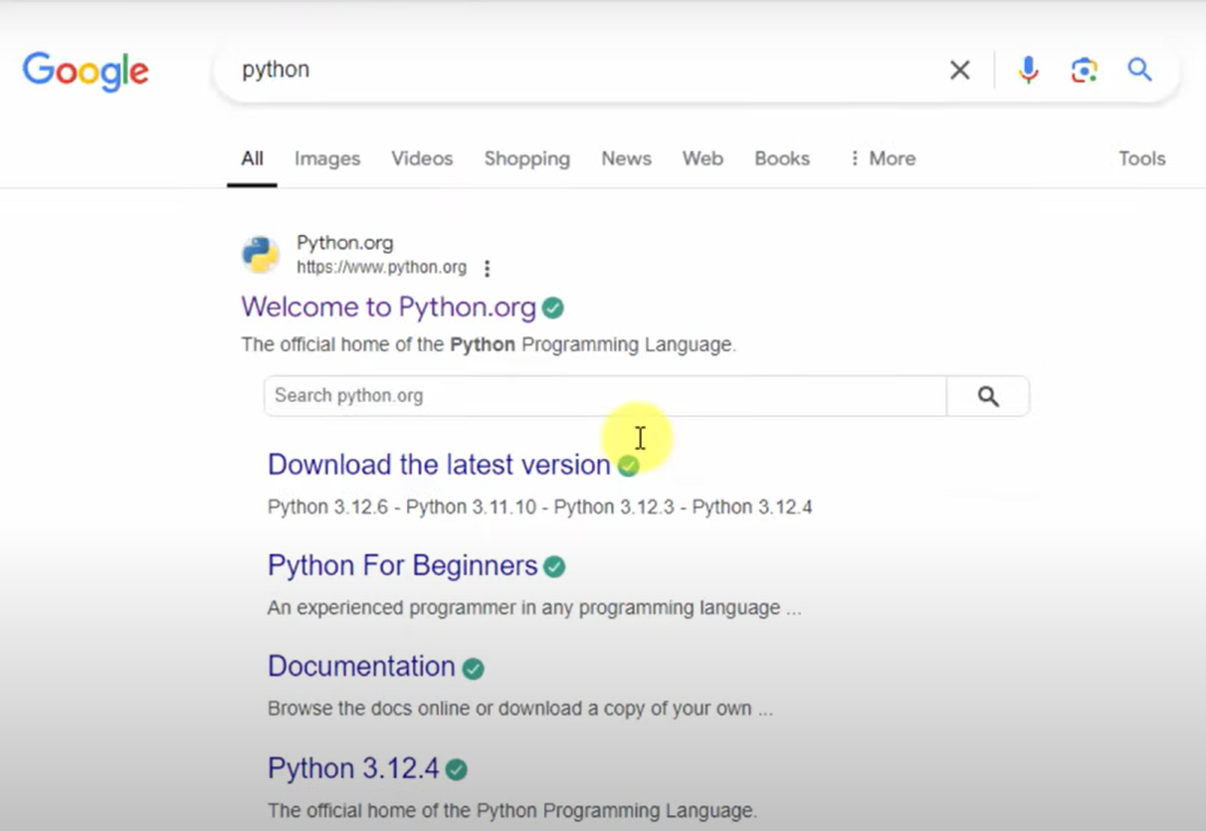
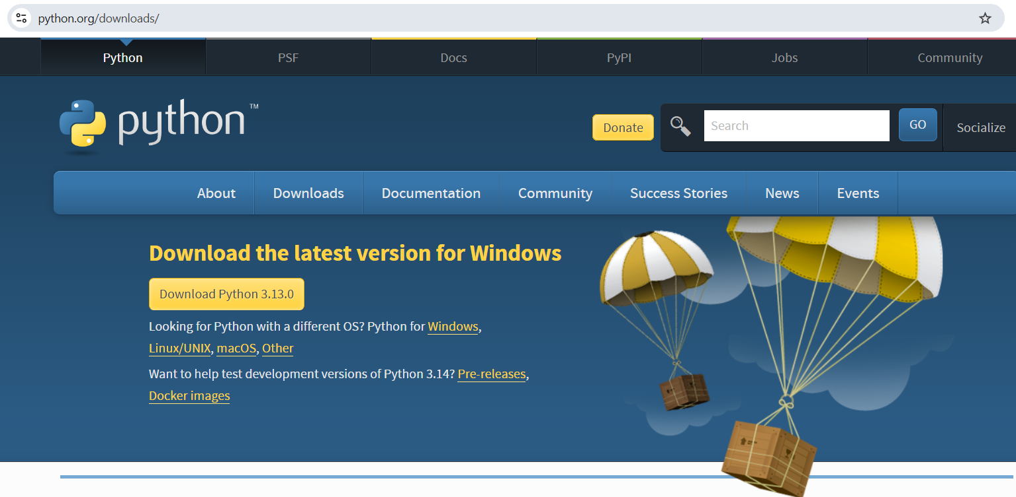
Installing Python-Windows
1.
Search Python in Google
2.
Open python.org

Slide 11
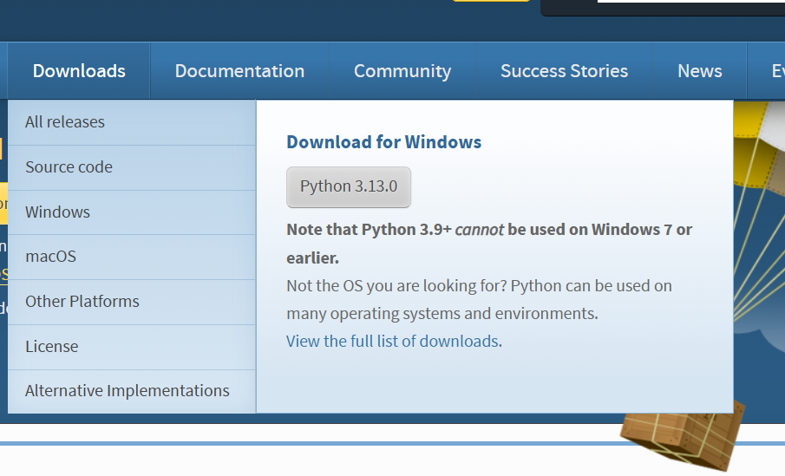
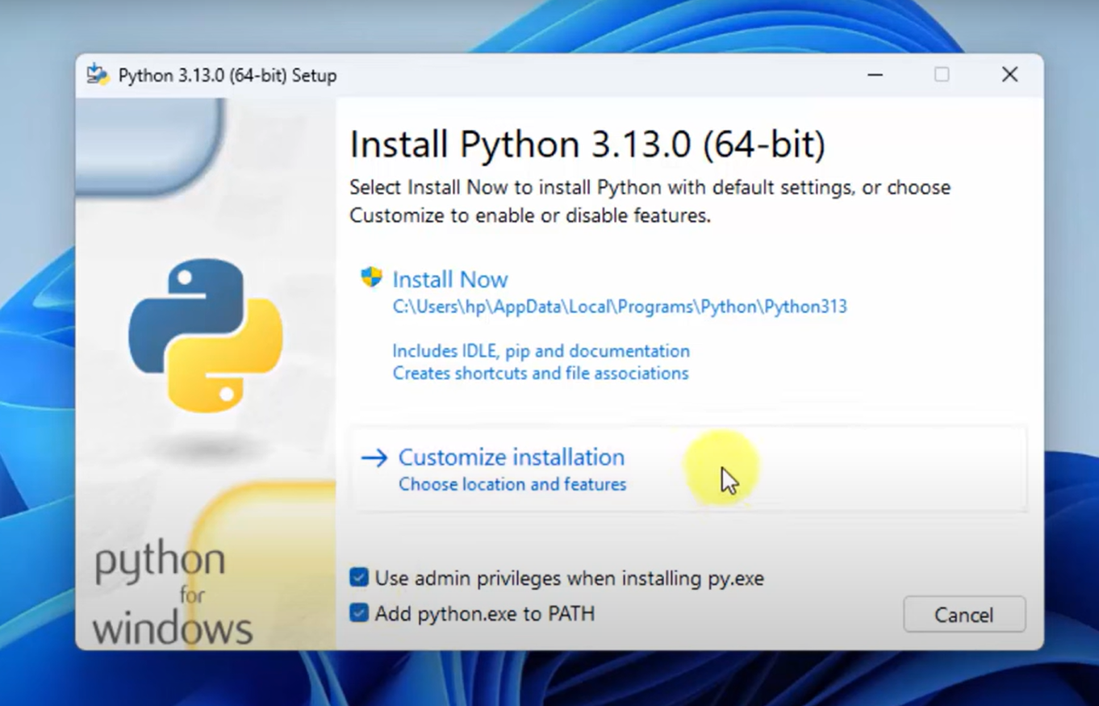
Installing Python-Windows (cont.)
3.
Download the installer
4.
Run .exe
and
Select Customize installation

Slide 12
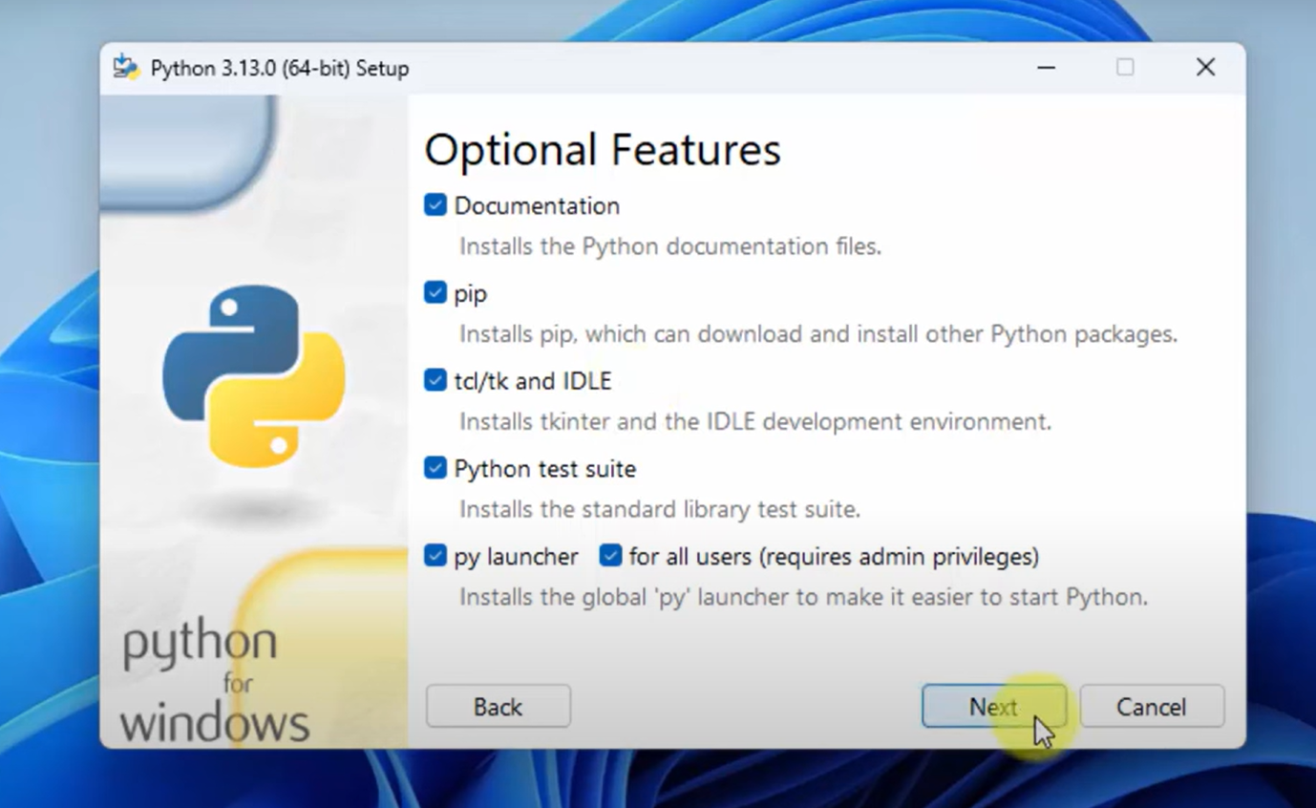
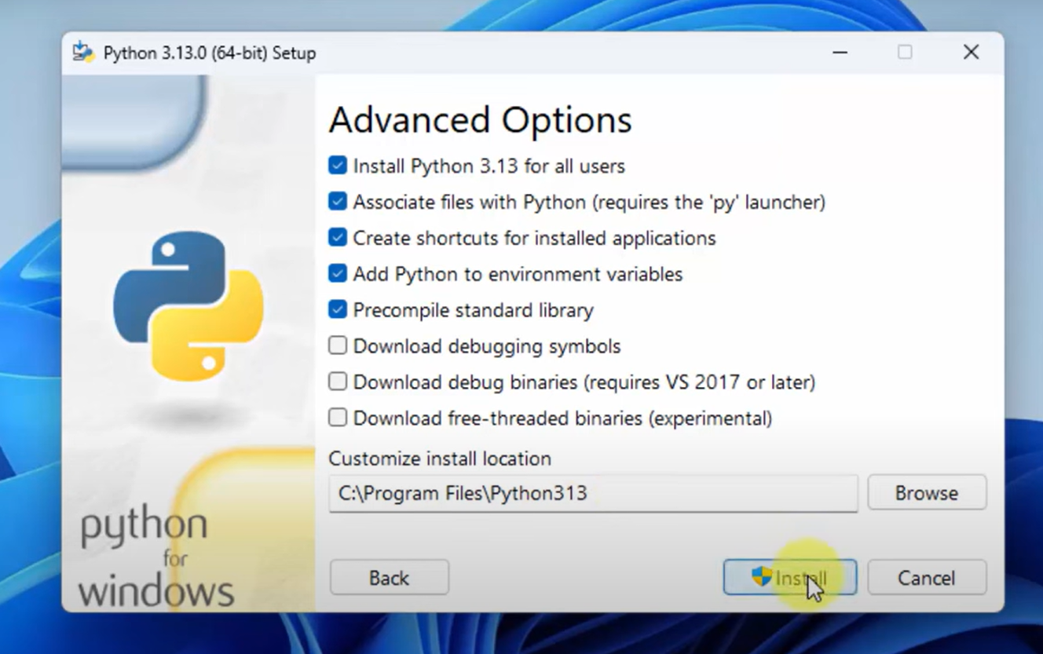
Installing Python-Windows (cont.)
5.
Select all Optional Features
6.
Select Advanced Options

Slide 13
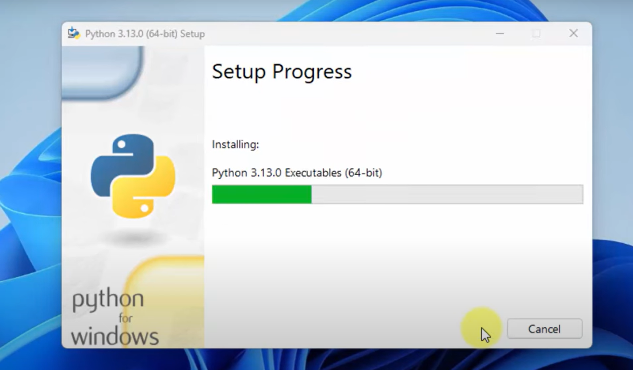
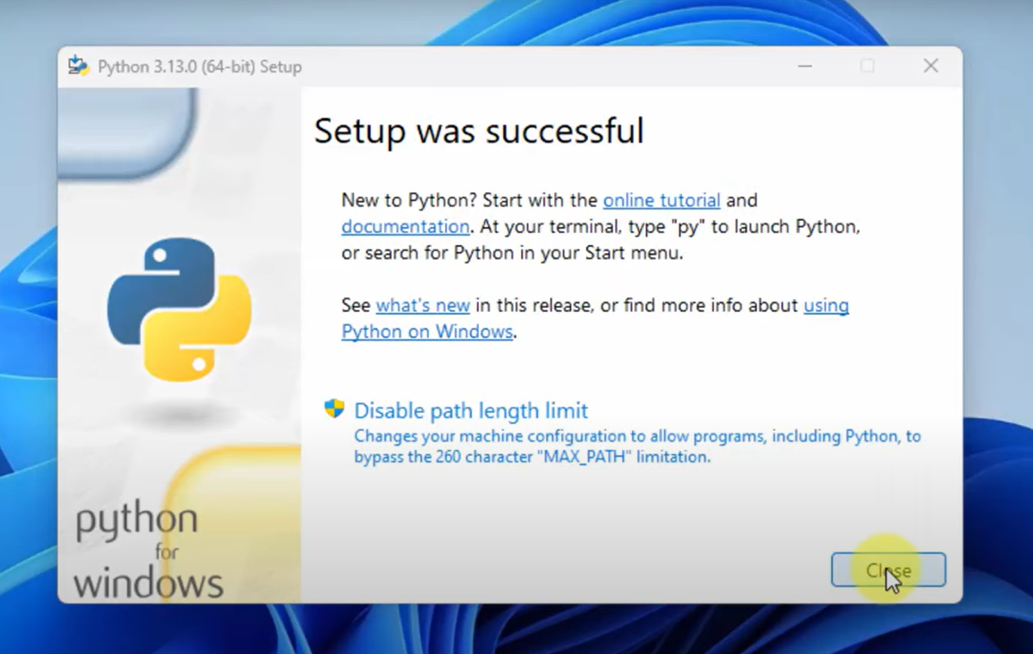
Installing Python-Windows (cont.)
7.
Installation started
8.
Installation completed

Slide 14
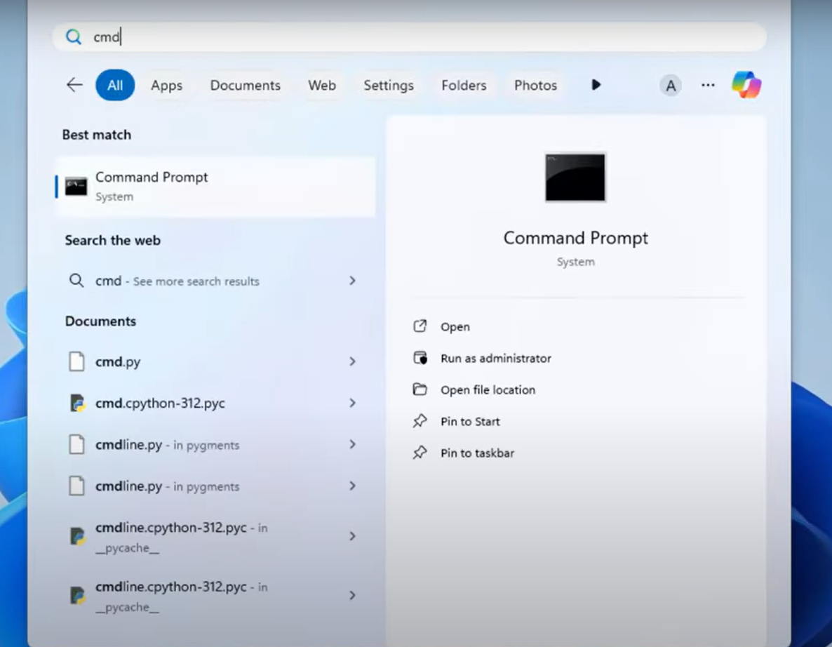
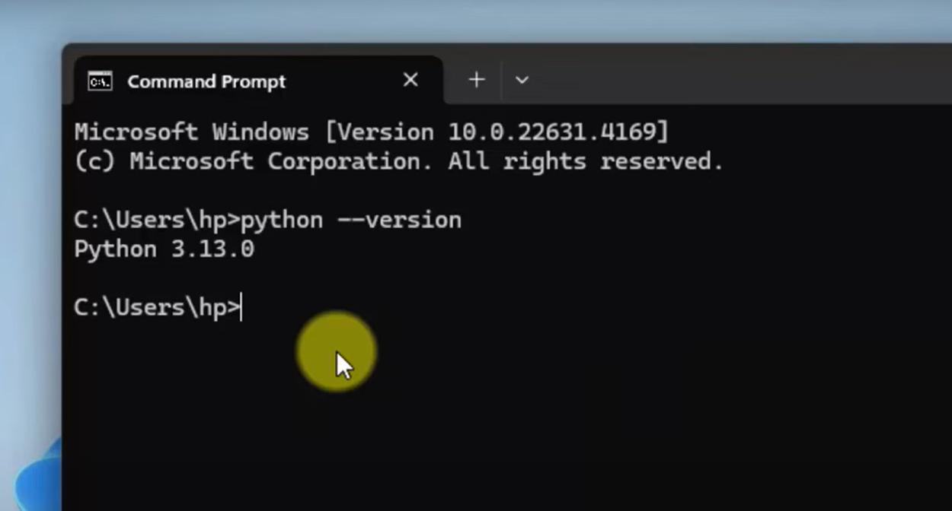
Installing Python-Windows (cont.)
9.
Verify installation : open cmd
10.
Type : python --version

Slide 15
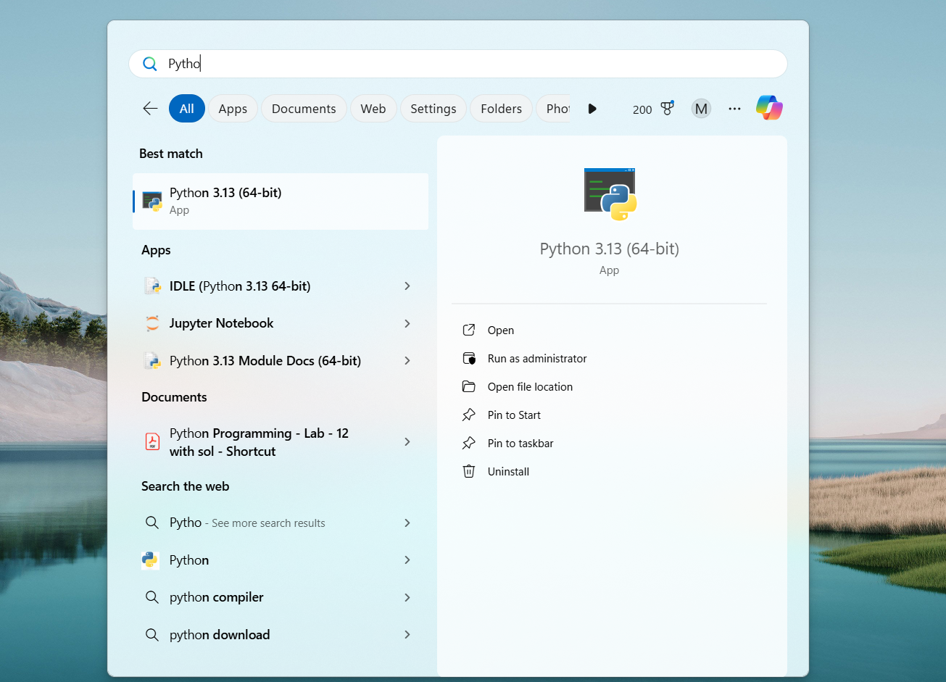
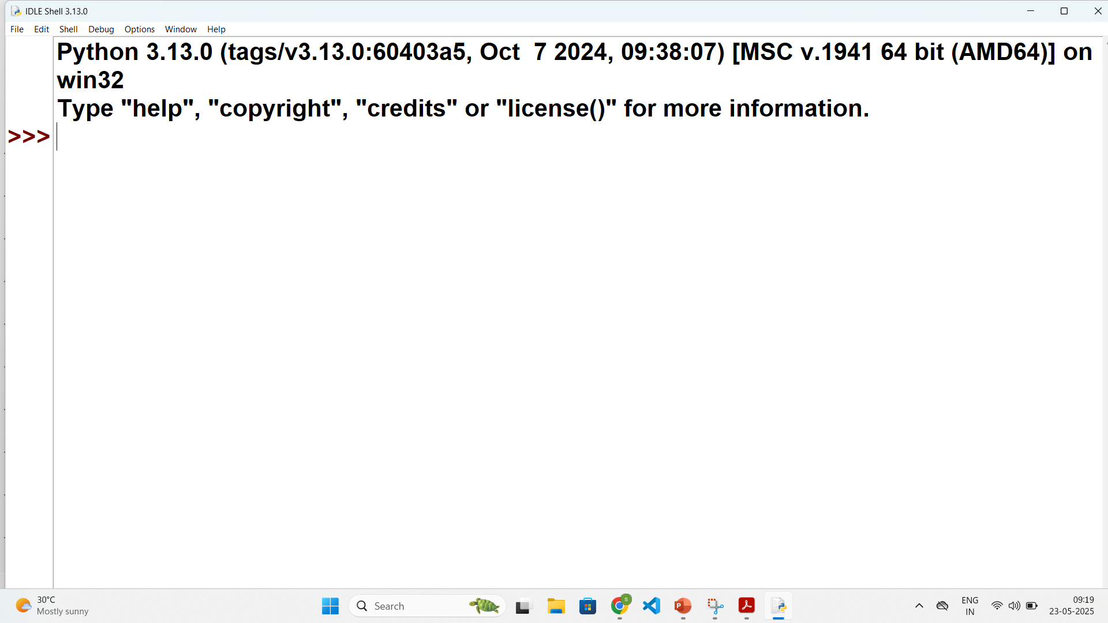
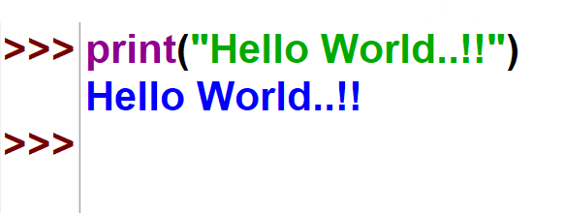
User Interface and IDE (Integrated Development Environment)
To write python programs, we can use any text editors or IDE.
To run the python file open command prompt and change directory to where your python file is.
Next, run python command (python filename.py)
Version of Python Interpreter : 3.13.0
Python Prompt : this is where programming in interactive mode can be done
Open Python IDLE
Python Shell

Slide 16
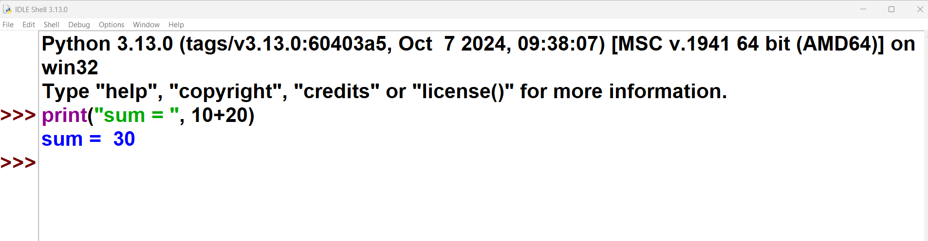
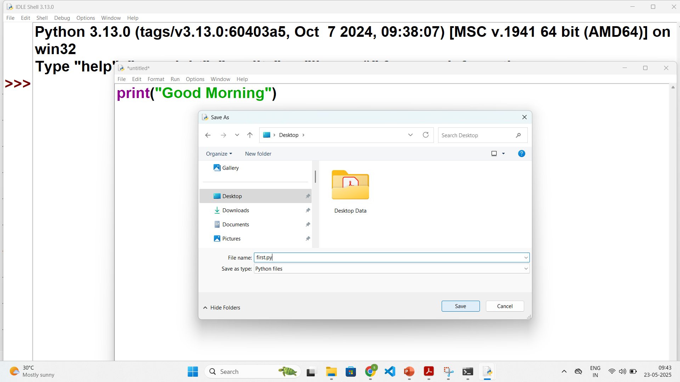
User Interface and IDE (cont.)
Python supports two modes of programming:
Interactive Mode
The code is written directly at the Python prompt (>>>).
The output is displayed immediately.
The code written in this mode is not saved, so it has to be written each time.
Thus it is preferred for experimentation purposes.
Script Mode
The code is written in the file and then the file is run.
The advantage of script mode is that the file can be saved for later use.
To Save : IDLE -> File -> New File -> write code -> Save As -> .py extension
To Run : Run -> Run Module OR (F5)
Interactive Mode Programming
File
Run
Script Mode Programming

Slide 17


Anaconda for Python
Anaconda is a popular open-source distribution of the Python and R programming languages.
Anaconda comes packed with a suite of powerful tools designed to enhance your data science and machine learning workflow.
Following are some most useful ones:
Jupyter Notebook
Spyder
Rstudio
VS Code (Visual Studio Code)
Anaconda Navigator
TensorFlow, etc…
We will use Jupyter Notebook for doing interactive programming and getting immediate visualization.

Slide 18


Installing Anaconda
1.
Search anaconda python
2.
Download the suitable Installer

Slide 19
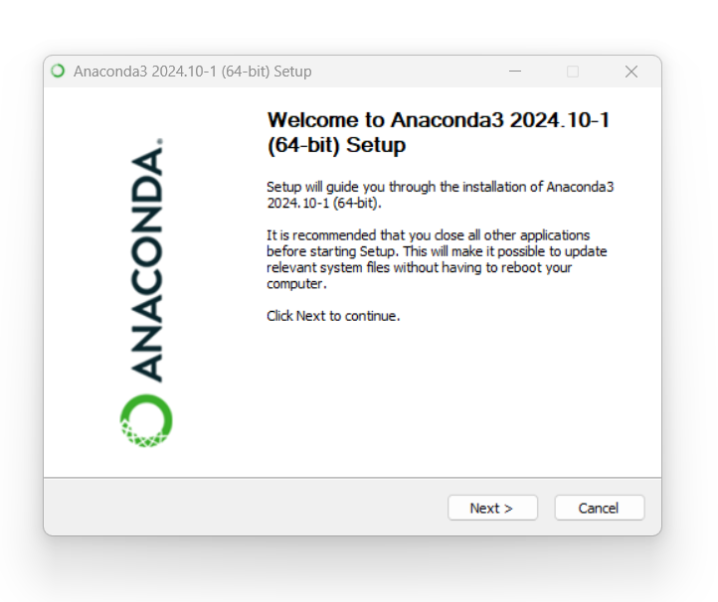
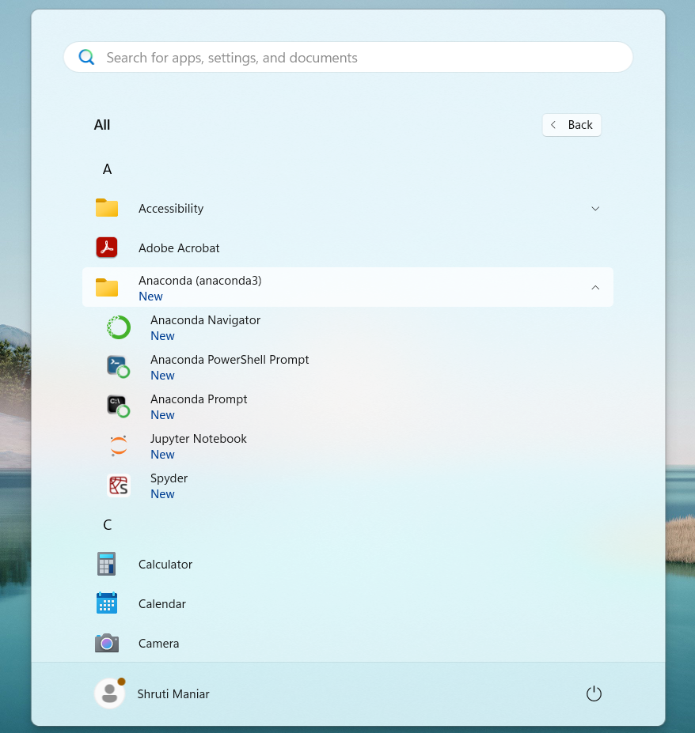
Installing Anaconda (cont.)
3.
Follow the steps on wizard
4.
Verify the installation

Slide 20
Working with Jupyter Notebook
Install Anaconda (if not already installed)
Launch Jupyter Notebook (Two ways):
Create a New Notebook
In the browser window, click New > Python 3.
A new notebook will open in a new tab.
Write Your First Program
Click inside the first cell.
Type your Python code
Run the Code
Click the Run button (triangle at the top), or
Press Shift+Enter to run the cell and move to the next
Steps to write the first program of Python using Jupyter Notebook
Using Command Prompt(windows)/ Terminal(linux)
Open your Anaconda Prompt (or terminal on linux)
Type: jupyter notebook
This will open Jupyter in your web browser (usually at http://localhost:8888).
1.
Using Anaconda Navigator (GUI)
Open Anaconda Navigator.
Click "Launch" under Jupyter Notebook.
2.

Slide 21
Indentation
Indentation in general means is, indenting words/spaces/lines in the document to follow the styling rule for documentation.
Indentation in Python refers to the (spaces and tabs) that are used at the beginning of a statement.
The statements with the same indentation belong to the same group called a suite.
Most programming languages like C, C++, Java, etc. use curly braces {} to define/identify a block of code in the program,
While in Python, it is done using the spaces or tabs, which is known as Indentation.
It is generally known as 4 space rule in Pep8 documentation of rules for styling and designing the code for Python.
Example.py
1
2
3
4
if Condition:
print("True")
else:
print("False")
IndentationError: unindent does not match any outer indentation level

Slide 22
Comments
In Python, comments are used to explain code and make it more readable.
They are ignored by the Python interpreter when the code is executed.
There are two main types of comments in Python:
Single-line Comments:
These are created using the # symbol.
Everything after the #, on that line is considered to be a comment.
Multi-line Comments:
These can be done using triple quotes (‘ ‘ ’ or “ ” ”).
# This is Single-line Comment
print("Hello World..!!") #This comment is on the same line
''' This is Multiline Comment
that spans multiple lines
'''
print("Hello World..!!")
""" Another multiline comments
using triple quotes
"""

Slide 23
Reding input
For taking input from the user, input() is used.
The syntax of input function is as follows:
When input statement is executed, the prompt is displayed on the screen, and it waits for the user action.
Whatever you enter as input, the input() converts it into a string.
If you enter an integer value still input() function convert it into a string, that will need to be type casted.
Syntax
1
input([prompt])
Parameter Name | Description
prompt | A string to be displayed on the screen (optional)

Slide 24
Print output
The print() function prints the specified message to the screen, or other standard output device. The object will be converted into a string before written to the screen.
Syntax
1
print(object(s), sep=‘ ‘, end=‘\n’, file=sys.stdout, flush=False)
Parameter Name | Description
Object(s) | One or more items to print. Can be string, number, variable, etc. Will be converted into string before printing.
sep | A string inserted between the objects (optional), Default : one space (‘ ‘)
end | A string to print at the end (optional), Default : '\n'
file | Where to send the output, Default : sys.stdout (the screen) output can be redirected to the file as well
flush | Flush the buffer? (Trur / False), Default : False

Slide 25
Example
Example.py
Output
1
2
3
4
5
6
7
9
10
11
12
13
14
a = 4
str = input("Enter your name = ")
num = int(input("Enter Number = "))
print(4,5)
print("Hello","World")
print("Hello","World",sep="-")
print("Hello","DU",sep="-",end=" ")
print("Hello " + "DU ")
print("a = ", a,end=", ")
print("num = ", num)
print("your Name ="+ str)
print("Your Name ",str,sep="=")
Enter your name = ABC
Enter Number = 10
4 5
Hello World
Hello-World
Hello-DU Hello DU
a = 4, num = 10
your Name =ABC
Your Name =ABC

Slide 26
Program 1
WAP to develop simple calculator in python
Example1.py
1
2
3
4
5
6
number1 = int(input("Enter first number: "))
number2 = int(input("Enter second number: "))
print(number1, "+", number2, "=", number1+number2)
print(number1, "*", number2, "=", number1*number2)
print(number1, "-", number2, "=", number1-number2)
print(number1, "/", number2, "=", number1/number2)
Output
Enter first number: 3
Enter second number: 3
3 + 3 = 6
3 * 3 = 9
3 - 3 = 0
3 / 3 = 1.0

Slide 27
Program 2
WAP to calculate simple interest
Example2.py
1
2
3
4
5
P = int(input("Enter P: "))
R = int(input("Enter R: "))
T = int(input("Enter N: "))
Simple_interest = (P * R * T) / 100
print("The simple interest is:", Simple_interest)
Output
Enter P: 10000
Enter R: 5
Enter N: 1
The simple interest is: 500.0

Slide 28
Program 3
WAP to calculate area of circle.
Example3.py
1
2
3
4
PI = 3.14
r = float(input("Enter the radius of a circle:"))
area = PI * r * r
print("Area of a circle = %.2f" %area)
Output
Enter the radius of a circle:100
Area of a circle = 31400.00

Slide 29
Unit-01.2 Python Object and Data Structure
Python for Data Science (2305CS303)
Prof. Shruti Maniar
Computer Engineering Department
shruti.maniar@darshan.ac.in
(O) 9727747317

Slide 30

Outline
Data types
Tokens
Variables : Numbers, Boolean, String
Type Conversions
Concept of Mutability
Indexing and Slicing of String
Formatting String
String Functions
List
Set
Tuple
Dictionary
Magic Commands
Looping

Slide 31
Variable in Python
A Python variable is a named reference to a value stored in memory.
Unlike other programming languages, Python has no command for declaring a variable.
A variable is created the moment you first assign a value to it.
Python uses Dynamic Typing so,
We need not to specify the data types to the variable as it will internally assign the data type to the variable according to the value assigned.
we can also reassign new value of the different data type to the same variable, variable data type will change to new data type automatically.
We can check the current data type of the variable with type(variablename) in-built function.
Rules for Variable Name :
Variable Name must begin with Letter or Underscore(_), it can not start with digit.
Remaining characters of the Variable Name can be letters, numbers or Underscore.
Spaces and Special Characters(except underscore) are not allowed.
Python Keywords are not allowed to be a Variable Name.
Variable Names are Case-Sensitive.

Slide 32
Example of Python variable
Example :
demo.py
1
2
3
4
5
6
7
8
9
10
x = 10
print(x)
print(type(x))
y = 123.456
print(y)
x = "darshan insitute of engneering and technology"
print(x)
print(type(x))
Reassign same variable to hold different data type
Run in terminal
1
python demo.py
Output
1
2
3
4
5
10
int
123.456
Darshan institute of engineering and technology
str

Slide 33
Data Type | Class | Description
Data Types
Integer | int | Whole number such as 0,1,5, -5 etc..
Float | float | Numbers with decimal points such as 1.5, 7.9, -8.2 etc..
Complex Number | complex | Complex number (real_part)+(imaginary_part)j such as 2 + 3j
String | str | Sequence of character (Ordered) such as “darshan”, ‘college’, “રાજકોટ” etc..
Boolean | bool | Logical values indicating Ture or False (T and F here are capital in python)
Data Structures
List | list | Ordered Sequence of objects, will be represented with square brackets [ ] Example : [ 18, “darshan”, True, 102.3 ]
Tuple | Tup | Ordered immutable sequence of objects, will be represented with round brackets ( ) Example : ( 18, “darshan”, True, 102.3 )
Set | Set | Unordered collection of unique objects, will be represented with the curly brackets { } Example : { 18, “darshan”, True, 102.3 }
Dictionary | Dict | Ordered key : value pair of objects , will be represented with curly brackets { } Example : { “college”: “darshan”, “code”: “054” }

Slide 34
Tokens
In Python, a Token is the smallest unit of a program.
Tokens are the building blocks of a Python program. Here are the main types of tokens in Python:
Keywords : Reserved words that have special meaning and cannot be used as identifiers. Example : If, else, for, while, try, except, etc.
Identifiers: Names given to variables, functions, classes, and other objects.
Literals: Constant values used in programs. They can be of various types (string, numeric, boolean, etc..)
Operators: Symbols that perform operations on one or more operands. Example : +,-,*,/,==, !=,etc.
Delimiters: Symbols used to separate code elements. Example : (),[],{}, : , ; and comma(,).
Comments: Text added to the code for documentation purposes, which is ignored by the Python interpreter. Example : #, ’ ’ ’ ,” ” ”

Slide 35
Tokens
# This is a comment
x = 42 # x is identifier , 42 is literal
if x > 0: # if is keyword, > is operator, 0 is literal
print("x is positive") # print is function, "x is positive" is string literal

Slide 36
Operators in Python
Operators are used for performing operations on variables and values.
We can segregate python operators in following groups,
Arithmetic operators
Assignment operators
Comparison operators
Logical operators
Bitwise operators
Identity operators
Membership operators

Slide 37
Arithmetic Operators
Arithmetic operators can be used with numeric values or variables to perform common mathematical operations
Note : consider A = 10 and B = 3
Imp. Point: Python does not support pre/post increment(++)/decrement(--) operators
Operator | Description | Example | Output
+ | Addition | A + B | 13
- | Subtraction | A - B | 7
/ | Division | A / B | 3.3333333333333335
* | Multiplication | A * B | 30
% | Modulus return the remainder | A % B | 1
// | Floor division returns the quotient | A // B | 3
** | Exponentiation | A ** B | 10 * 10 * 10 = 1000

Slide 38
Assignment Operators
Assignment Operators are used to assigning values to variables.
Note : consider A = 3, B = 5 and C = 0
Operator | Description | Example | Output
= | Assign | C = A + B | 8
+= | Add and Assign | A+=B | 8
-= | Subtract and Assign | A-=B | -2
*= | Multiply and Assign | A*=B | 15
/= | Divide and Assign | A/=B | 0.6
%= | Modulus and Assign | A%=B | 3
//= | Divide(floor) and Assign | A//=B | 0
**= | Power and Assign | A**=B | 243

Slide 39
Relational Operators
Relational operators are used for comparing the values. It either returns True or False according to the condition.
Note : consider A = 9, B = 5
Operator | Description | Example | Output
> | Greater than | A > B | True
< | Less than | A < B | False
== | Equal to | A == B | False
!= | Not Equal to | A != B | True
>= | Greater than or equal to | A >= B | True
<= | Less than or equal to | A <= B | False

Slide 40
Logical Operators
Logical Operators are used to perform logical operations on the values of variables. The value is either true or false. We can figure out the conditions by the result of the truth values.
Note : consider A = 10 and B = 3
Operator | Description | Example | Output
and | Returns True if both statements are true | A > 5 and B < 5 | True
or | Returns True if one of the statements is true | A > 5 or B > 5 | True
not | Negate the result, returns True if the result is False | not ( A > 5 ) | False

Slide 41
Bitwise Operators
The bitwise operators are used to performing bitwise calculations on integers. The integers are first converted into binary and then operations are performed on bit by bit, hence the name bitwise operators. Then the result is returned in decimal format.
Note : consider A = 10(binary - 1010) and B = 4(binary - 0100)
Operator | Description | Example | Output
A | Bitwise AND | A & B | 0
| | Bitwise OR | A | B | 14
~ | Bitwise NOT | ~A | -11
^ | Bitwise XOR | A ^ B | 14
>> | Bitwise right shift | A>>1 | 5
<< | Bitwise left shift | A<<1 | 20

Slide 42
Example
Example.py
1
2
3
4
5
6
7
9
10
11
12
13
14
15
16
17
18
19
20
21
22
23
24
25
x , y = 5,2
a,b = True,False
#Arithmetic operator
print('x // y =',x//y)
print('x ** y =',x**y)
#Assignemnt Operator
x+=5 # x = 10
y+=2 # y = 4
print('x y =',x,y)
#Comparison Operator
print('x >= y is',x>=y)
print('x <= y is',x<=y)
#Logical Operator
print('x and y is',a and b)
print('x or y is',a or b)
print('not x is',not a)
#Bitwise Operators
print('x & y is',x & y)
print('x | y is',x | y)
Output
x // y = 2
x ** y = 25
x y = 10 4
x >= y is True
x <= y is False
x and y is False
x or y is True
not x is False
x & y is 0
x | y is 14

Slide 43
Conditional and Looping Statements
The statements that help us to control the flow of execution in a program called control statements.
There are two types of control statements.
Branching Statement :
The statements that help us to select some statements for execution and skip other statements.
These statements are also called as decision making statements because they make decision based on some condition and select some statements for execution.
If statement
if-else statement
nested if statement
elif statement
Looping statements:
The statements that help us to execute set of statements repeatedly are called as looping statements.
For loop statement
While loop statement

Slide 44
If statement
if statement is written using the if keyword followed by condition and colon(:) .
Code to execute when the condition is true will be ideally written in the next line with Indentation (white space).
Python relies on indentation to define scope in the code (Other programming languages often use curly-brackets for this purpose).
Syntax
if statement ends with :
1
2
if some_condition :
# Code to execute when condition is true
Indentation (tab/whitespace) at the beginning
ifdemo.py
Output
1
2
3
4
x = 10
if x > 5 :
print("X is greater than 5")
1
X is greater than 5

Slide 45
If else statement
This is basically a “two-way” decision statement. This is used when we must choose between two alternatives.
Syntax
1
2
3
4
if some_condition :
# Code to execute when condition is true
else :
# Code to execute when condition is false
ifelsedemo.py
Output
1
2
3
4
5
6
x = 3
if x > 5 :
print("X is greater than 5")
else :
print("X is less than 5")
1
X is less than 5

Slide 46
Example of if else
Example1.py
Output
1
2
3
4
5
6
# Program checks if the number is positive or negative
num = int(input("Enter Number="))
if num >= 0:
print("Positive number")
else:
print("Negative number")
Enter Number = 5
Positive number
Example2.py
Output
1
2
3
4
5
6
# Program checks if the number is Odd or Even
num = int(input("Enter Number="))
if num % 2 == 0:
print("Even number")
else:
print("Odd number")
Enter Number = 4
Positive number

Slide 47
Nested if statement
An if-else statement is written within another if-else statement is called nested if statement.
Syntax
1
2
3
4
5
if some_condition1 :
if some_condition2 :
# Code to execute when condition is true
else :
# Code to execute when condition is false
Output
Enter a Number = 4
Positive number
Example1.py
1
2
3
4
5
6
7
9
num = float(input("Enter a number: "))
if num >= 0:
if num == 0:
print("Zero")
else:
print("Positive number")
else:
print("Negative number")

Slide 48
Example
Example1.py
Output
1
2
3
4
5
6
7
8
9
10
11
12
13
14
15
16
17
# find maximum number from three number
a = int(input("Enter A="))
b = int(input("Enter B="))
c = int(input("Enter C="))
if a>b:
if a>c:
g=a
else:
g=c
else:
if b>c:
g=b
else:
g=c
print("Greater = ",g)
Enter A=10
Enter B=9
Enter C=2
Greater = 10

Slide 49
If, elif and else statement
The elif is short for else if. It allows us to check for multiple expressions.
If the condition for if is False, it checks the condition of the next elif block and so on.
If all the conditions are False, the body of else is executed.
Only one block among the several if...elif...else blocks is executed according to the condition.
The if a block can have only one else block, but it can have multiple elif blocks.
This statement is alternative for nested if statement to overcome the complexity problem involved in nested if statement.

Slide 50
If, elif and else statement
Syntax
1
2
3
4
5
6
if some_condition_1 :
# Code to execute when condition 1 is true
elif some_condition_2 :
# Code to execute when condition 2 is true
else :
# Code to execute when both conditions are false
ifelifdemo.py
Output
1
2
3
4
5
6
7
8
x = 10
if x > 12 :
print("X is greater than 12")
elif x > 5 :
print("X is greater than 5")
else :
print("X is less than 5")
1
X is greater than 5

Slide 51
Example
Example1.py
Output
1
2
3
4
5
6
7
8
9
10
11
12
13
14
15
16
17
18
19
20
21
22
23
24
25
# Python Program to find Student Grade
english = float(input(" Please enter English Marks: "))
math = float(input(" Please enter Math score: "))
computers = float(input(" Please enter Computer Marks: "))
physics = float(input(" Please enter Physics Marks: "))
chemistry = float(input(" Please enter Chemistry Marks: "))
total = english + math + computers + physics + chemistry
percentage = (total / 500) * 100
print("Total Marks = %.2f" %total)
print("Marks Percentage = %.2f" %percentage)
if(percentage >= 90):
print("A Grade")
elif(percentage >= 80):
print("B Grade")
elif(percentage >= 70):
print("C Grade")
elif(percentage >= 60):
print("D Grade")
elif(percentage >= 40):
print("E Grade")
else:
print("Fail")
Please enter English Marks: 50
Please enter Math score: 50
Please enter Computer Marks: 50
Please enter Physics Marks: 50
Please enter Chemistry Marks: 50
Total Marks = 250.00
Marks Percentage = 50.00
E Grade

Slide 52
For loop in python
Many objects in python are iterable, meaning we can iterate over every element in the object.
such as every elements from the List, every characters from the string etc..
We can use for loop to execute block of code for each element of iterable object.
Syntax
For loop ends with :
1
2
for temp_item in iterable_object :
# Code to execute for each object in iterable
Indentation (tab/whitespace) at the beginning
fordemo1.py
Output :
1
2
3
4
fordemo2.py
Output :
2
4
6
8
1
2
3
my_list = [1, 2, 3, 4]
for list_item in my_list :
print(list_item)
1
2
3
4
my_list = [1,2,3,4,5,6,7,8,9]
for list_item in my_list :
if list_item % 2 == 0 :
print(list_item)

Slide 53
range() function
The range() function returns a sequence of numbers, starting from 0 by default, and increments by 1 (by default), and stops before a specified number.
Syntax
1
range(start, stop, step)
Example1.py
Example2.py
Example3.py
Example4.py
1
2
3
x = range(3, 6)
for n in x:
print(n)
1
2
3
x = range(3, 20, 2)
for n in x:
print(n)
1
2
3
x = range(20)
for n in x:
print(n)
1
2
3
x = reversed(range(20))
for n in x:
print(n)
Output
Output
Output
Output
3
4
5
3
5
-
19
0
1
-
19
19
18
-
0

Slide 54
For loop (tuple unpacking)
Sometimes we have nested data structure like List of tuples, and if we want to iterate with such list we can use tuple unpacking.
withouttupleunapacking.py
withtupleunpacking.py
1
2
3
my_list = [(1,2,3), (4,5,6), (7,8,9)]
for list_item in my_list :
print(list_item[1])
1
2
3
my_list = [(1,2,3), (4,5,6), (7,8,9)]
for a,b,c in my_list :
print(b)
Output :
2
5
8
This technique is known as tuple unpacking
Output :
2
5
8

Slide 55
For loop with else
The else block just after for/while is executed only when the loop is NOT terminated by a break statement.
Example1.py
Example2.py
1
2
3
4
for i in range(1, 4):
print(i)
else:
print("No Break")
1
2
3
4
5
for i in range(1, 4):
print(i)
break
else: # Not executed as there is a break
print("No Break")
Output
Output
1
2
3
No Break
1

Slide 56
Example
Example1.py
Output
1
2
3
4
5
#odd numbers between 1 to n
num = int(input("Enter Number = "))
for i in range(1,num+1):
if i % 2 != 0:
print(i)
Enter Number = 5
1
3
5
Example2.py
Output
1
2
3
4
5
6
#series 1 + 4 + 9 + 16 + 25 + 36 + ...n
num = int(input("Enter Number = "))
sum = 0
for i in range(1,num+1):
sum = sum + i**2
print("Sum=",sum)
Enter Number = 10
Sum= 385

Slide 57
Example
Example3.py
Output
1
2
3
4
5
6
# Find factorial of the given number
num = int(input("Enter Number = "))
fact = 1
for i in range(1,num+1):
fact = fact * i
print("Factorial =", fact )
Enter Number = 5
Factorial = 120
Example4.py
Output
1
2
3
4
5
6
7
8
9
#series 1 – 2 + 3 – 4 + 5 – 6 + 7 ... n
num = int(input("Enter Number = "))
sum = 0
for i in range(1,num+1):
if i % 2 == 0:
sum = sum - i
else:
sum = sum + i
print("Sum=",sum)
Enter Number = 10
Sum= -5

Slide 58
While loop
While loop will continue to execute block of code until some condition remains True.
For example,
while felling hungry, keep eating
while have internet pack available, keep watching videos
Syntax
while loop ends with :
1
2
while some_condition :
# Code to execute in loop
Output :
X is greater than 3
Indentation (tab/whitespace) at the beginning
withelse.py
1
2
3
4
5
6
x = 5
while x < 3 :
print(x)
x += 1 # x++ is invalid in python
else :
print("X is greater than 3")
whiledemo.py
Output :
0
1
2
1
2
3
4
x = 0
while x < 3 :
print(x)
x += 1 # x++ is invalid in python

Slide 59
Example
Example1.py
Output
1
2
3
4
5
6
7
#odd numbers between 1 to n
num = int(input("Enter Number = "))
i=0
while(i<=num):
if i % 2 != 0:
print(i)
i+=1
Enter Number = 5
1
3
5
Example2.py
Output
1
2
3
4
5
6
7
#series 1 + 4 + 9 + 16 + 25 + 36 + ...n
num = int(input("Enter Number = "))
sum = i = 0
while(i<=num):
sum = sum + i**2
i+=1
print("Sum=",sum)
Enter Number = 10
Sum= 385

Slide 60
Exercise programs
Do Following programs using for and while loop.
WAP to find out sum of first and last digit of a given number
WAP to find whether the given number is prime or not.
WAP to find out prime numbers between given two numbers
WAP to print given number in reverse order.
WAP to check whether the given number is Armstrong or not.
WAP to find the sum of 1 + (1+2) + (1+2+3) + (1+2+3+4)+ …+(1+2+3+4+….+n).

Slide 61
break keyword
Breaks out of the current closest enclosing loop.
Break Statement is a loop control statement that is used to terminate the loop.
As soon as the break statement is encountered from within a loop, the loop iterations stop there, and control returns from the loop immediately to the first statement after the loop.
Basically, break statements are used in situations when we are not sure about the actual number of iterations for the loop or we want to terminate the loop based on some condition.
Syntax
1
break
breakdemo.py
Output :
0
1
1
2
3
4
5
for temp in range(5) :
if temp == 2 :
break
print(temp)

Slide 62
continue keyword
Goes to the top of the current closest enclosing loop.
Continue statement is a loop control statement that forces to execute the next iteration of the loop while skipping the rest of the code inside the loop for the current iteration only i.e.
When the continue statement is executed in the loop, the code inside the loop following the continue statement will be skipped for the current iteration and the next iteration of the loop will begin.
Syntax
1
continue
continuedemo.py
Output :
0
1
3
4
1
2
3
4
5
for temp in range(5) :
if temp == 2 :
continue
print(temp)

Slide 63
pass keyword
Does nothing at all, will be used as a placeholder in conditions where you don’t want to write anything.
The pass statement is a null statement. But the difference between pass and comment is that comment is ignored by the interpreter whereas pass is not ignored.
Syntax
1
pass
passdemo.py
Output : (nothing)
1
2
for temp in range(5) :
pass

Slide 64
String in python
String is Ordered Sequence of character such as “darshan”, ‘college’, “રાજકોટ” etc..
Strings are arrays of bytes representing Unicode characters.
String can be represented as single, double or triple quotes.
String with triple Quotes allows multiple lines.
String in python is immutable.
Square brackets can be used to access elements of the string, Ex. “Darshan”[1] = a, characters can also be accessed with reverse index like “Darshan”[-1] = n.
String index
x = " D a r s h a n "
index = 0 1 2 3 4 5 6
Reverse index = -7 -6 -5 -4 -3 -2 -1

Slide 65
String Slicing
We can get the substring in python using string slicing, we can specify start index, end index and steps (colon separated) to slice the string.
syntax
x = 'darshan institute of engineering and technology, rajkot, gujarat, INDIA'
subx = x[startindex:endindex:steps]
endindex will not be included in the substring
strslicedemo.py
1
2
3
4
5
6
7
8
9
10
11
x = 'darshan institute of engineering and technology, rajkot, gujarat, INDIA'
subx1 = x[0:7]
subx2 = x[49:55]
subx3 = x[66:]
subx4 = x[::2]
subx5 = x[::-1]
print(subx1)
print(subx2)
print(subx3)
print(subx4)
print(subx5)
Output : darshan
Output : rajkot
Output : INDIA
Output : drhnisiueo niern n ehooy akt uaa,IDA
Output : AIDNI ,tarajug ,tokjar ,ygolonhcet dna gnireenigne fo etutitsni nahsrad

Slide 66
String functions in python
Python has lots of built-in methods that you can use on strings, we are going to cover some frequently used methods for string like
len()
count()
title(), lower(), upper()
istitle(), islower(), isupper()
find(), rfind(), replace()
index(), rindex()
Methods for validations like
isalpha(), isalnum(), isdecimal(), isdigit()
strip(), lstrip(), rstrip()
split
Etc..
Note : len() is not the method of the string but can be used to get the length of the string
lendemo.py
Output : 7 (length of “Darshan”)
1
2
x = "Darshan"
print(len(x))

Slide 67
String methods (cont.)
count() method will returns the number of times a specified value occurs in a string.
title(), lower(), upper() will returns capitalized, lower case and upper case string respectively.
countdemo.py
1
2
3
x = "Darshan"
ca = x.count('a')
print(ca)
Output : 2 (occurrence of ‘a’ in “Darshan”)
changecase.py
1
2
3
4
5
6
7
x = "darshan Institute, rajkot"
c = x.title()
l = x.lower()
u = x.upper()
print(c)
print(l)
print(u)
Output : Darshan Institute, Rajkot
Output : darshan institute, rajkot
Output : DARSHAN INSTITUTE, RAJKOT

Slide 68
String methods (cont.)
istitle(), islower(), isupper() will returns True if the given string is capitalized, lower case and upper case respectively.
strip() method will remove whitespaces from both side of the string and returns the string.
rstrip() and lstrip() will remove whitespaces from right and left side respectively.
checkcase.py
1
2
3
4
5
6
7
x = 'darshan institute, rajkot'
c = x.istitle()
l = x.islower()
u = x.isupper()
print(c)
print(l)
print(u)
Output : False
Output : True
Output : False
stripdemo.py
1
2
3
x = ' Darshan '
f = x.strip()
print(f)
Output : Darshan (without space)

Slide 69
String methods (cont.)
find() method will search the string and returns the index at which they find the specified value
rfind() will search the string and returns the last index at which they find the specified value
Note : find() and rfind() will return -1 if they are unable to find the given string.
replace() will replace str1 with str2 from our string and return the updated string
finddemo.py
1
2
3
x = 'darshan institute, rajkot, india'
f = x.find('in')
print(f)
Output : 8 (occurrence of ‘in’ in x)
rfinddemo.py
1
2
3
x = 'darshan institute, rajkot, india'
r = x.rfind('in')
print(r)
Output : 27 (last occurrence of ‘in’ in x)
replacedemo.py
1
2
3
x = 'darshan institute, rajkot, india'
r = x.replace('india','INDIA')
print(r)
Output : “darshan institute, rajkot, INDIA”

Slide 70
String methods (cont.)
index() method will search the string and returns the index at which they find the specified value, but if they are unable to find the string it will raise an exception.
rindex() will search the string and returns the last index at which they find the specified value , but if they are unable to find the string it will raise an exception.
Note : find() and index() are almost same, the only difference is if find() is unable to find the string it will return -1 and if index() is unable to find the string it will raise an exception.
indexdemo.py
1
2
3
x = 'darshan institute, rajkot, india'
f = x.index('in')
print(f)
Output : 8 (occurrence of ‘in’ in x)
rindexdemo.py
1
2
3
x = 'darshan institute, rajkot, india'
r = x.rindex('in')
print(r)
Output : 27 (last occurrence of ‘in’ in x)

Slide 71
String methods (cont.)
isalnum() method will return true if all the characters in the string are alphanumeric (i.e either alphabets or numeric).
isalpha() and isnumeric() will return true if all the characters in the string are only alphabets and numeric respectively.
isdecimal() will return true is all the characters in the string are decimal.
Note : isnuberic() and isdigit() are almost same, you suppose to find the difference as Home work assignment for the string methods.
isalnumdemo.py
1
2
3
x = 'darshan123'
f = x.isalnum()
print(f)
Output : True
isdecimaldemo.py
1
2
3
x = '123.5'
r = x.isdecimal()
print(r)
Output : True

Slide 72
String print format
str.format() is one of the string formatting methods in Python3, which allows multiple substitutions and value formatting.
This method lets us concatenate elements within a string through positional formatting.
We can specify multiple parameters to the function
strformat.py
1
2
3
4
x = '{} institute, rajkot'
y = x.format('darshan')
print(y)
print(x.format('ABCD'))
Output : darshan institute, rajkot
Inline function call
Output : ABCD institute, rajkot
strformat.py
1
2
3
4
x = '{} institute, {}'
y = x.format('darshan','rajkot')
print(y)
print(x.format('ABCD','XYZ'))
Output : darshan institute, rajkot
Inline function call
Output : ABCD institute, XYZ

Slide 73
String print format (cont.)
We can specify the order of parameters in the string
We can also specify alias within the string to specify the order
We can format the decimal values using format method
strformat.py
1
2
3
4
x = '{1} institute, {0}'
y = x.format('darshan','rajkot')
print(y)
print(x.format('ABCD','XYZ'))
Output : rajkot institute, darshan
Inline function call
Output : XYZ institute, ABCD
strformat.py
1
2
x = '{collegename} institute, {cityname}'
print(x.format(collegename='darshan',cityname='rajkot'))
Output : darshan institute, rajkot
strformat.py
1
2
3
per = (438 / 500) * 100
x = 'result = {r:3.2f} %'.format(r=per)
print(x)
Output : result = 87.60 %
width
precision

Slide 74
Identity & Member Operators
Identity Operator
Note : consider A = [1,2], B = [1,2] and C=A
Member Operator
Note : consider A = 2 and B = [1,2,3]
Operator | Description | Example | Output
is | Returns True if both variables are the same object | A is B A is C | False True
is not | Returns True if both variables are different object | A is not B | True
Operator | Description | Example | Output
in | Returns True if a sequence with the specified value is present in the object | A in B | True
not in | Returns True if a sequence with the specified value is not present in the object | A not in B | False

Slide 75
Example
Example.py
1
2
3
4
5
6
7
9
10
11
12
13
14
15
16
17
18
19
20
x2 = 'Hello'
y2 = 'Hello'
x3 = [1,2,3]
y3 = x3
x = 'Hello world'
y = {1:'a',2:'b'}
z = [1,2,3,4,5]
# Identity Operator
print("x2 is y2 = ",x2 is y2)
print("x3 is y3 = ",x3 is y3)
print("x2 is not y2 =",x2 is not y2)
# Membership Operator
print("'H' in x = ", 'H' in x)
print("'hello' not in x = ",'hello' not in x)
print("5 in z = ", 5 in z)
print("1 in y = ",1 in y)
Output
x2 is y2 = True
x3 is y3 = True
x2 is not y2 = False
'H' in x = True
'hello' not in x = True
5 in z = True
1 in y = True

Slide 76
Data structures in python
There are four built-in data structures in Python - list, dictionary, tuple and set.
Lets explore all the data structures in detail…
Name | Type | Description
List | list | Ordered Sequence of objects, will be represented with square brackets [ ] Example : [ 18, “darshan”, True, 102.3 ]
Dictionary | dict | Unordered key : value pair of objects , will be represented with curly brackets { } Example : { “college”: “darshan”, “code”: “054” }
Tuple | tup | Ordered immutable sequence of objects, will be represented with round brackets ( ) Example : ( 18, “darshan”, True, 102.3 )
Set | set | Unordered collection of unique objects, will be represented with the curly brackets { } Example : { 18, “darshan”, True, 102.3 }

Slide 77
List
List is a mutable ordered sequence of objects, duplicate values are allowed inside list.
List will be represented by square brackets [ ].
Python does not have array, List can be used similar to Array.
We can use slicing similar to string in order to get the sub list from the list.
list.py
Output : institute (List index starts with 0)
1
2
3
4
5
6
my_list = ['darshan', 'institute', 'rkot']
print(my_list[1])
print(len(my_list))
my_list[2] = "rajkot"
print(my_list)
print(my_list[-1])
Output : 3 (length of the List)
Output : ['darshan', 'institute', 'rajkot']
Note : spelling of rajkot is updated
Output : rajkot (-1 represent last element)
list.py
1
2
my_list = ['darshan', 'institute', 'rajkot','gujarat','INDIA']
print(my_list[1:3])
Output : ['institute', 'rajkot']
Note : end index not included

Slide 78
List methods
append() method will add element at the end of the list.
insert() method will add element at the specified index in the list
extend() method will add one data structure (List or any) to current List
appendlistdemo.py
1
2
3
my_list = ['darshan', 'institute', 'rajkot']
my_list.append('gujarat')
print(my_list)
Output : ['darshan', 'institute', 'rajkot', 'gujarat']
insertlistdemo.py
1
2
3
4
my_list = ['darshan', 'institute', 'rajkot']
my_list.insert(2,'of')
my_list.insert(3,'engineering')
print(my_list)
Output : ['darshan', 'institute', 'of', 'engineering', 'rajkot']
extendlistdemo.py
1
2
3
4
my_list1 = ['darshan', 'institute']
my_list2 = ['rajkot','gujarat']
my_list1.extend(my_list2)
print(my_list1)
Output : ['darshan', 'institute', ‘rajkot', ‘gujarat']

Slide 79
List methods (cont.)
pop() method will remove the last element from the list and return it.
remove() method will remove first occurrence of specified element
clear() method will remove all the elements from the List
index() method will return first index of the specified element.
poplistdemo.py
1
2
3
4
my_list = ['darshan', 'institute','rajkot']
temp = my_list.pop()
print(temp)
print(my_list)
Output : rajkot
Output : ['darshan', 'institute‘]
removelistdemo.py
1
2
3
my_list = ['darshan', 'institute', 'darshan','rajkot']
my_list.remove('darshan')
print(my_list)
Output : ['institute', 'darshan', 'rajkot']
clearlistdemo.py
1
2
3
my_list = ['darshan', 'institute', 'darshan','rajkot']
my_list.clear()
print(my_list)
Output : []

Slide 80
List methods (cont.)
count() method will return the number of occurrence of the specified element.
reverse() method will reverse the elements of the List
sort() method will sort the elements in the List
countlistdemo.py
1
2
3
my_list = ['darshan', 'institute', 'darshan','rajkot']
c = my_list.count('darshan')
print(c)
Output : 2
reverselistdemo.py
1
2
3
my_list = ['darshan', 'institute','rajkot']
my_list.reverse()
print(my_list)
Output : ['rajkot', ‘institute','darshan']
sortlistdemo.py
1
2
3
4
5
my_list = ['darshan', 'college','of','enginnering','rajkot']
my_list.sort()
print(my_list)
my_list.sort(reverse=True)
print(my_list)
Output : ['college', 'darshan', 'enginnering', 'of', 'rajkot']
Output : ['rajkot', 'of', 'enginnering', 'darshan', 'college']

Slide 81
List Comprehension
List comprehensions offer a way to create lists based on existing iterable. When using list comprehensions, lists can be built by using any iterable, including strings, list, tuples.
For example, if we want to create a list of characters from the string, we can use for loop like below example,
Syntax
ForLoop.py
[ expression for item in iterable ]
OR
[ expression for item in iterable if condition ]
1
2
3
4
5
mystr = 'darshan'
mylist = []
for c in mystr:
mylist.append(c)
print(mylist)
Example1.py
1
2
mylist = [c for c in 'darshan']
print(mylist)
Output
['d', 'a', 'r', 's', 'h', 'a', 'n']

Slide 82
List Comprehension (cont.)
Similarly, we can use list comprehensions in many cases where we want to create a list out of other iterable, let’s see another example of the use of List Comprehension.
Example (Using for loop):
ForLoop1.py
Example2.py
1
2
3
4
5
#list of square from 1 to 10
mylist = []
for i in range(1,11):
mylist.append(i**2)
print(mylist)
1
2
3
# list of square from 1 to 10
mylist = [ i**2 for i in range(1,11) ]
print(mylist)
Output
[1, 4, 9, 16, 25, 36, 49, 64, 81, 100]

Slide 83
Tuple
Tuple is a immutable ordered sequence of objects, duplicate values are allowed inside list.
Tuple will be represented by round brackets ( ).
Tuple is similar to List but List is mutable whereas Tuple is immutable.
tupledemo.py
1
2
3
4
5
Output : ('darshan', 'institute', 'of', 'engineering', 'of', 'rajkot')
my_tuple = ('darshan','institute','of','engineering','of','rajkot')
print(my_tuple)
print(my_tuple.index('engineering'))
print(my_tuple.count('of'))
print(my_tuple[-1])
Output : 3 (index of ‘engineering’)
Output : 2
Output : rajkot

Slide 84
Set
Set is a unordered collection of unique objects.
Set will be represented by curly brackets { }.
Set has many in-built methods such as add(), clear(), copy(), pop(), remove() etc.. which are similar to methods we have previously seen.
Only difference between Set and List is that Set will have only unique elements and List can have duplicate elements.
setdemo.py
1
2
my_set = {1,1,1,2,2,5,3,9}
print(my_set)
Output : {1, 2, 3, 5, 9}

Slide 85
Dictionary
Dictionary is a unordered collection of key value pairs.
Dictionary will be represented by curly brackets { }.
Dictionary is mutable.
syntax
my_dict = { 'key1':'value1', 'key2':'value2' }
Key value is seperated by :
Key value pairs is separated by ,
dictdemo.py
1
2
3
my_dict = {'college':"darshan", 'city':"rajkot",'type':"engineering"}
print(my_dict['college'])
print(my_dict.get('city'))
values can be accessed using key inside square brackets as well as using get() method
Output : darshan
rajkot

Slide 86
Dictionary methods
keys() method will return list of all the keys associated with the Dictionary.
values() method will return list of all the values associated with the Dictionary.
items() method will return list of tuples for each key value pair associated with the Dictionary.
keydemo.py
1
2
my_dict = {'college':"darshan", 'city':"rajkot",'type':"engineering"}
print(my_dict.keys())
Output : ['college', 'city', 'type']
valuedemo.py
1
2
my_dict = {'college':"darshan", 'city':"rajkot",'type':"engineering"}
print(my_dict.values())
Output : ['darshan', 'rajkot', 'engineering']
itemsdemo.py
1
2
my_dict = {'college':"darshan", 'city':"rajkot",'type':"engineering"}
print(my_dict.items())
Output : [('college', 'darshan'), ('city', 'rajkot'), ('type', 'engineering')]

Slide 87
List vs. tuple vs. set vs. dictionary
List | Tuple | Sets | Dictionaries
Ordered Data | Ordered Data | Unordered Data | Unordered Data
Mutable | immutable | mutable | mutable
Square braces.[] | Parenthesis () | Curly brackets {} | Curly brackets {key : value}
Duplicate elements allowed | Duplicate elements allowed | No Duplicate elements | No Duplicate key
append() | Element cannot be added | add() | update()
We can create a list using the list() function. | We can create a tuple using the tuple() function. | We can create a set using the set()function. | We can create a dictionary using the dict() function.
my_list = [5,6,7,8] | my_tuple = (5,6,7,8) | my_sets = {3,4,5,6} | my_dictionaries = {"name" : "XYZ", "rollno." : "101"}

Slide 88
Magic Command
IPython’s special commands (which are not built into Python itself) are known as “magic” commands.
These are designed to facilitate common tasks and enable you to easily control the behavior of the IPython system.
magic command is any command prefixed by the percent symbol %
For example, you can check the execution time of any Python statement, such as a matrix multiplication, using the %timeit magic function (which will be discussed in more detail later):
Magic commands come in two type:
line magics, which are denoted by a single % prefix and operate on a single line of input,
cell magics, which are denoted by a double %% prefix and operate on multiple lines of input.

Slide 89
Magic Command
Command | Description
%quickref | Display the IPython Quick Reference Card
%magic | Display detailed documentation for all of the available magic commands
%who, %whos, %who_ls | Print all information related to interactive variables.
%hist | Print command input (and optionally output) history
%cd | Change the current working directory.
%paste | Execute preformatted Python code from clipboard
%cpaste | Open a special prompt for manually pasting Python code to be executed
%reset | Delete all variables/names defined in interactive namespace
%page OBJECT | Pretty-print the object and display it through a pager
%run script.py | Run a Python script inside IPython
%time statement | Report the execution time of a single statement
%timeit statement | Run a statement multiple times to compute an ensemble average execution time; useful for timing code with very short execution time

Slide 90
Introspection
Using a question mark (?) before or after a variable will display some general infor‐ mation about the object:
Then using ? shows us the docstring if defined.
Using ?? will also show the function’s source code if possible:
Introspection
Introspection
In[1]: In[2]:
b=[1,2,3]
b?
Type: list String Form:[1, 2, 3] Length: 3 Docstring: list() -> new empty list list(iterable) -> new list initialized from iterable's items
In[1]:
add_numbers??
Signature: add_numbers(a, b) Source: def add_numbers(a, b):
"""
Add two numbers together Returns ------- the_sum : type of arguments
""" return a+b
File: <ipython-input-9-6a548a216e27> Type: function

Slide 91
The %run Command
You can run any file as a Python program inside the environment of your IPython session using the %run command.
All of the variables (imports, functions, and globals) defined in the file (up until an exception, if any, is raised) will then be accessible in the IPython shell:
lPython
In[1]:
In[2]:
Out[2]:
In[3]:
Out[3]:
%run demo.py
c
7.5
result
1.4666666666666666
demo.py
1
2
3
4
5
6
7
8
def f(x, y, z):
return(x+y)/z
a=5
b=6
c=7.5
result = f(a, b, c)

Slide 92
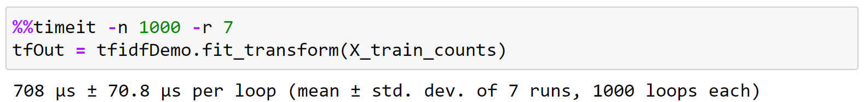
timeit (Magic Command in Jupyter Notebook)
We can find the time taken to execute a statement or a cell in a Jupyter Notebook with the help of timeit magic command.
This command can be used both as a line and cell magic:
In line mode you can time a single-line statement (though multiple ones can be chained with using semicolons).
In cell mode, the statement in the first line is used as setup code (executed but not timed) and the body of the cell is timed. The cell body has access to any variables created in the setup code.
Syntax :
Line : %timeit [-n<N> -r<R> [-t|-c] -q -p<P> -o]
Cell : %%timeit [-n<N> -r<R> [-t|-c] -q -p<P> -o]
Here, -n flag represents the number of loops and –r flag represents the number of repeats
Example :

Slide 93
Unit-02.2 Functions
Python For Data Science(2305CS303)
Prof. Shruti R. Maniar
Computer Engineering Department
shruti.maniar@darshan.ac.in
(O) 9727747317

Slide 94

Outline
Creating function
DOCSTRING
Types of arguments
Calling function
return statement
Scope of Variables
Lambda expression
Recursion
Looping

Slide 95
Functions in python
Creating clean repeatable code is a key part of becoming an effective programmer.
A function is a block of code which only runs when it is called.
In Python a function is defined using the def keyword:
Syntax
ends with :
def function_name() :
#code to execute when function is called
Indentation (tab/whitespace) at the beginning
Output :
hello world
==============================
from darshan college
==============================
rajkot
Functiondemo.py
1
2
3
4
5
6
7
8
def seperator() :
print('==============================')
print("hello world")
seperator()
print("from darshan college")
seperator()
print("rajkot")

Slide 96
Function (cont.)
There are two kinds of functions in Python.
Built-in functions that are provided as part of Python - input(), print()...
Functions that we define ourselves and then use
We treat the of the built-in function names as "new" reserved words (i.e. we avoid them as variable names)
In Python a function is some reusable code that takes arguments(s) as input does some computation and then returns a result(s)
We call/invoke the function by using the function name, parenthesis and arguments in an expression
Function name
Functiondemo.py
Arguments
1
2
a = max(2,90)
print(a)

Slide 97
Function Names
Use a naming scheme, and use it consistently (camel case syntax).
For all names, avoid abbreviations, unless they are both standardized and widely used.
The name should describe the data’s meaning rather than its type (e.g., amount_due rather than money),
Functions and methods should have names that say what they do or what they return (depending on their emphasis), but never how they do it—since that might change.
All three functions below return the index position of the first occurrence of a name in a list of names, starting from the given starting index and using an algorithm that assumes the list is already sorted.
Functiondemo.py
1
2
3
def find(l, s, i=0): # BAD
def linear_search(l, s, i=0): # BAD
def first_index_of(sorted_name_list, name, start=0): # GOOD

Slide 98
Function (cont.) (DOCSTRING & return)
Doc string helps us to define the documentation about the function within the function itself.
Unlike conventional source code comments, the docstring should describe what the function does, not how.
The docstrings can be accessed using the __doc__ method of the object or using the help function.
Syntax
Enclosed within triple quotes
def function_name() :
'''
DOCSTRING: explains the function
INPUT: explains input
OUTPUT: explains output
'''
#code to execute when function is called
Help.py
1
Function_name. __doc__

Slide 99
Function Types
Four kinds of functions can be created in Python: global functions, local functions, lambda functions, and methods.
Global function
Global objects (including functions) are accessible to any code in the same module (i.e., the same .py file) in which the object is created.
Local functions
(also called nested functions) are functions that are defined inside other functions. These functions are visible only to the function where they are defined;
They are especially useful for creating small helper functions that have no use elsewhere.
Lambda functions
Lambda functions are expressions, so they can be created at their point of use;
however, they are much more limited than normal functions.
Methods
Methods are functions that are associated with a particular data type and can be used only in conjunction with the data type (when we cover object-oriented programming. )

Slide 100
Exercise
WAP to count simple interest using function.
WAP to find maximum number from given two numbers using function.
WAP that defines a function exchange to interchange the values of two variables, say x and y.

Slide 101
Function Arguments
A function by using the following types of formal arguments:
Required arguments
Keyword arguments
Default arguments
Variable-length arguments
Required arguments
Required arguments are the arguments passed to a function in correct positional order.
During a function call, values passed through arguments should be in the order of parameters in the function definition.
Demo.py
Output
1
2
3
4
5
def add_number(n1,n2):
print("Sum = ", n1+n2)
add_number(2,3)
add_number(3,5)
Sum = 5
Sum = 8

Slide 102
Function Arguments(cont.)
Keyword arguments
When you use keyword arguments in a function call, the caller identifies the arguments by the parameter name.
This allows you to skip arguments or place them out of order because the Python interpreter is able to use the keywords provided to match the values with parameters.
Functions can also be called using keyword arguments of the form kwarg=value
During a function call, values passed through arguments need not be in the order of parameters in the function definition. This can be achieved by keyword arguments.
Demo.py
Output
1
2
3
4
5
def subtract_number(n1,n2):
print("Subtraction = ", n1-n2)
subtract_number(20,10)
subtract_number(n2=20,n1=10) Keyword Arguments
Subtraction = 10
Subtraction = -10

Slide 103
Function Arguments(cont.)
Default arguments
A default argument is an argument that assumes a default value if a value is not provided in the function call for that argument.
Default arguments are values that are provided while defining functions.
The assignment operator = is used to assign a default value to the argument.
Default arguments become optional during the function calls.
If we provide a value to the default arguments during function calls, it overrides the default value.
Default arguments should follow non-default arguments.
Demo.py
Output
1
2
3
4
5
def add_number(n1,n2 = 10):
print("Sum = ", n1+n2)
add_number(2,3)
add_number(3)
Sum = 5
Sum = 13

Slide 104
Function Arguments(cont.)
Variable-length arguments
Variable-length arguments are also known as arbitrary arguments. If we don’t know the number of arguments needed for the function in advance, we can use arbitrary arguments.
There are two types of variable length arguments
Arbitrary positional arguments
You may need to process a function for more arguments than you specified while defining the function.
These arguments are called variable-length arguments and are not named in the function definition, unlike required and default arguments.
An asterisk (*) is placed before the variable name that will hold the values of all non keyword variable arguments.
This tuple remains empty if no additional arguments are specified during the function call
Tuple representing variable length arguments
Syntax
def functionname([formal_args,] *var_args_tuple ):
#code to execute when function is called

Slide 105
Function Arguments(cont.)
Arbitrary positional arguments example
Demo.py
Output
1
2
3
4
5
6
7
8
def add_number(n1,*n):
sum = n1
for i in n:
sum = sum + i
print("Sum = ", sum)
add_number(2)
add_number(10,10,10,10)
Sum = 2
Sum = 40

Slide 106
Function Arguments(cont.)
Arbitrary keyword arguments
For arbitrary positional argument, a double asterisk (**) is placed before a parameter in a function which can hold keyword variable-length arguments.
Demo.py
Output
1
2
3
4
5
6
7
8
9
def add_Number(**a):
sum = 0
sum = a['a'] + a['b']
print("Sum=",sum)
for i in a.items():
print(i)
print(a)
add_Number(a=4,b=3,c=4)
Sum= 7
('a', 4)
('b', 3)
('c', 4)
{'a': 4, 'b': 3, 'c': 4}

Slide 107
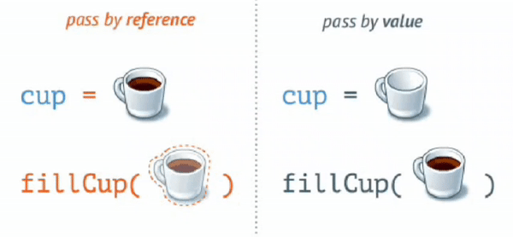
Pass by reference vs value
In call by value method, the value of the actual parameters is copied into the formal parameters.
In call by reference, the address of the variable is passed into the function call as the actual parameter.
In python value is passed as “Call by Object Reference” or “Call by assignment”.
When we pass whole numbers, strings or tuples to a function, the passing is like call-by-value because you can not change the value of the immutable objects being passed to the function.
Whereas passing mutable objects can be considered as call by reference because when their values are changed inside the function, then it will also be reflected outside the function.

Slide 108
Pass by reference vs value
CallByValue.py
CallByReference.py
1
2
3
4
5
6
7
8
9
# Call by Value
def modifiy_String(s):
s = "Darshan University"
print("Inside Function:", s)
str = "Darshan"
modifiy_String(str)
print("Outside Function:",str)
1
2
3
4
5
6
7
8
9
# Call by Reference
def add_more(list):
list.append(50)
print("Inside Function:", list)
list = [1,2,3,4,5]
add_more(list)
print("Outside Function:",list)
Output
Output
Inside Function: Darshan University
Outside Function: Darshan
Inside Function: [1, 2, 3, 4, 5, 50]
Outside Function: [1, 2, 3, 4, 5, 50]

Slide 109
Pass by reference vs value
def printA(a):
a = 3
def printList(a):
a.append(3)
x=2
printA(x)
print("A = ",x)
x= [1,2]
printList(x)
print("List",x)
Call by Value
Call by Reference
X
a
X
a
2
2
[1,2]

Slide 110
return Statement
return statement : return allows us to assign the output of the function to a new variable, return is use to send back the result of the function, instead of just printing it out.
A return statement is used to end the execution of the function call. The statements after the return statements are not executed.
If the return statement is without any expression, then the special value None is returned.
In python we can return multiple values from function using object, tuple, list, Dictionary.
returnDemo.py
1
2
3
4
5
6
7
def add_number(n1,n2) :
return n1 + n2
sum1 = add_number(5,3)
sum2 = add_number(6,1) print(sum1)
print(sum2)
Output :
8
7

Slide 111
return Multiple values
returndemo.py
Output
1
2
3
4
5
6
7
8
9
10
11
def test():
a=1
b=2
c=3
return a,b,c # return multiple values
x = test()
a,b,c = test()
print(x)
print(x[1])
print("a, b, c=",a,b,c)
(1, 2, 3)
2
a, b, c= 1 2 3

Slide 112
Exercise
WAP that define a function to find factorial of given number.
WAP that defines a function which returns 1 if the number is prime otherwise return 0.
WAP to generate Fibonacci series of N given number using function name fibbo.
WAP that defines a function to add first n numbers.

Slide 113
Scope of Variables
All variables in a program may not be accessible at all locations in that program. This depends on where you have declared a variable.
The scope of a variable determines the portion of the program where you can access a particular identifier. There are two basic scopes of variables in Python:
Global variables
Local variables
Variables that are defined inside a function body have a local scope, and those defined outside have a global scope.
This means that local variables can be accessed only inside the function in which they are declared.
whereas global variables can be accessed throughout the program body by all functions.
When we call a function, the variables declared inside it are brought into scope.

Slide 114
Scope of Variables (cont.)
Local.py
Output
1
2
3
4
5
6
7
8
total = 0
def sum( arg1, arg2 ):
total = arg1 + arg2
print ("Inside the function local total : ", total)
return total; # Now you can call sum function
sum( 10, 20 );
print ("Outside the function global total : ", total)
Inside the function local total : 30
Outside the function global total : 0
Global.py
Output
1
2
3
4
5
6
7
8
9
total = 0
def sum( arg1, arg2 ):
global total
total = arg1 + arg2
print ("Inside the function local total : ", total)
return total; # Now you can call sum function
sum( 10, 20 );
print ("Outside the function global total : ", total)
Inside the function local total : 30
Outside the function global total : 30

Slide 115
Lambda Function
We can use the lambda keyword to create small anonymous functions.
These functions are called anonymous because they are not declared in the standard manner by using the def keyword.
Lambda forms can take any number of arguments but return just one value in the form of an expression. They cannot contain multiple expressions.
An anonymous function cannot be a direct call to print because lambda requires an expression.
Lambda functions have their own local namespace and cannot access variables other than those in their parameter list and those in the global namespace.
Although it appears that lambda's are a one-line version of a function, they are not equivalent to inline statements in C or C++

Slide 116
Lambda Function (cont.)
Syntax
1
lambda arg1,arg2..argN: expression
The parameters are optional, and if supplied they are normally just comma- separated variable names, that is, positional arguments.
Lambda functions accept all kinds of arguments, just like normal def function
The expression can not contain branches or loops (although conditional expressions are allowed), and cannot have a return statement. The result of a lambda expression is an anonymous function.
When a lambda function is called it returns the result of computing the expression as its result.
Example.py
1
2
sum = lambda arg1,arg2: arg1 + arg2
print("Total",sum(5,5))
Output
Total 10

Slide 117
Lambda Function (cont.)
Cube.py
Output
1
2
3
4
5
6
7
8
def cube(y):
return y*y*y
lambda_cube = lambda y: y*y*y
# using the normally defined function
print(cube(5))
# using the lambda function
print(lambda_cube(5))
125
125
WithIfElse.py
Output
1
2
3
# Example of lambda function using if-else
Max = lambda a, b : a if(a > b) else b
print(Max(1, 2))
2
call.py
Output
1
2
# Lambda functions can be Immediately Invoked
print((lambda x: x*x)(3))
9

Slide 118
Exercise
WAP to find square of given number using lambda expression.
WAP to find simple interest using lambda function.
WAP to make simple calculator using lambda expression.

Slide 119
Map
map() function returns a map object(which is an iterator) of the results after applying the given function to each item of a given iterable (list, tuple etc.)
Syntax
1
map(fun, iterable)
demo1.py
Output
1
2
3
4
5
6
7
def addition(n):
return n * n
numbers = [1, 2, 3, 4]
result = list(map(addition, numbers))
# result = list(map(lambda n:n*n,numbers))
print(result)
[1, 4, 9, 16]
demo2.py
Output
1
2
3
strdata = ["Darshan","University"]
lengthdata = list(map(len,strdata))
print(lengthdata)
[7, 10]

Slide 120
Functional Programming Tools: filter and reduce
To find out items based on a test function we can use a Filter.
For example, the following filter call picks out items in a sequence that are divide by 2:
demo1.py
Output
1
2
3
lista = [1,2,3,4,5,6,7,8,9,10]
ans = list(filter(lambda x: x % 2 == 0 ,lista))
print(ans)
[2, 4, 6, 8, 10]

Slide 121
Functional Programming Tools: filter and reduce
Apply functions to pairs of items and running results (reduce(fun,seq)).
In the first step, the first two elements of the sequence are chosen, and the result is obtained.
The result is then stored after applying the same function to the previously obtained result and the number just succeeding the second element.
This process is repeated until there are no more elements in the container.
The final result is returned and printed to the console.
demo1.py
Output
1
2
3
4
from functools import reduce
lista = [1,2,3,4,5,6,7,8,9,10]
ans = reduce(lambda a,b : a+b,lista)
print(ans)
55
demo2.py
Output
1
2
3
4
from functools import reduce
lista = [1,2,3,4,5,6,7,8,9,10]
ans = reduce(lambda a,b : a if a>b else b,lista)
Print(ans)
10

Slide 122
Recursion
Any function which calls itself is called recursive function and such function calls are called recursive calls.
Recursion cannot be applied to all problems, but it is more useful for the tasks that can be defined in terms of a similar subtask.
It is idea of representing problem a with smaller problems.
Any problem that can be solved recursively can be solved iteratively.
When recursive function call itself, the memory for called function allocated and different copy of the local variable is created for each function call.
Some of the problem best suitable for recursion are
Factorial
Fibonacci
Tower of Hanoi

Slide 123
Properties of Recursion
A recursive function can go infinite like a loop. To avoid infinite running of recursive function, there are two properties that a recursive function must have.
Base Case or Base criteria
It allows the recursion algorithm to stop.
A base case is typically a problem that is small enough to solve directly.
Progressive approach
A recursive algorithm must change its state in such a way that it moves forward to the base case.

Slide 124
Recursion - factorial example
The factorial of a integer n, is product of
n * (n-1) * (n-2) * …. * 1
Recursive definition of factorial
n! = n * (n-1)!
Example
3! = 3 * 2 * 1
3! = 3 * (2 * 1)
3! = 3 * (2!)
Recursive trace
Final Ans 5 *24 = 120
Fact(5)
return 4 * 6 = 24
call
Fact(4)
return 3 * 2 = 6
call
Fact(3)
return 2 * 1 = 2
call
Fact(2)
call
return 1
Fact(1)

Slide 125
Examples
Factorial.py
Output
1
2
3
4
5
6
7
8
9
10
def recursive_factorial(n):
if n == 1:
return n
else:
return n * recursive_factorial(n-1)
# recursive function call
# user input
num = int(input("Enter the number="))
print("Factorial of number", num, "=", recursive_factorial(num))
Enter the number=5
Factorial of number 5 = 120
fibonacci.py
Output
1
2
3
4
5
6
7
8
9
def r_fibonacci(n):
if n <= 1:
return n
else:
return(r_fibonacci(n-1) + r_fibonacci(n-2))
n = 8
print("Fibonacci series:")
for i in range(n):
print(r_fibonacci(i))
Fibonacci series:
0
1
1
-
-
13

Slide 126
Exercise
Write a program to find factorial of a given number using recursion.
WAP to convert decimal number into binary using recursion.
WAP to use recursive calls to evaluate F(x) = x – x3/3! + x5/5! – x7/7! + … + xn/n!

Slide 127
Thank You

